Slide 1
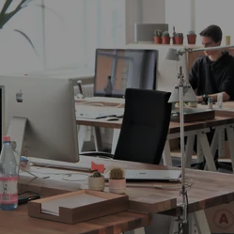
New
Functions availbale

Slide 2
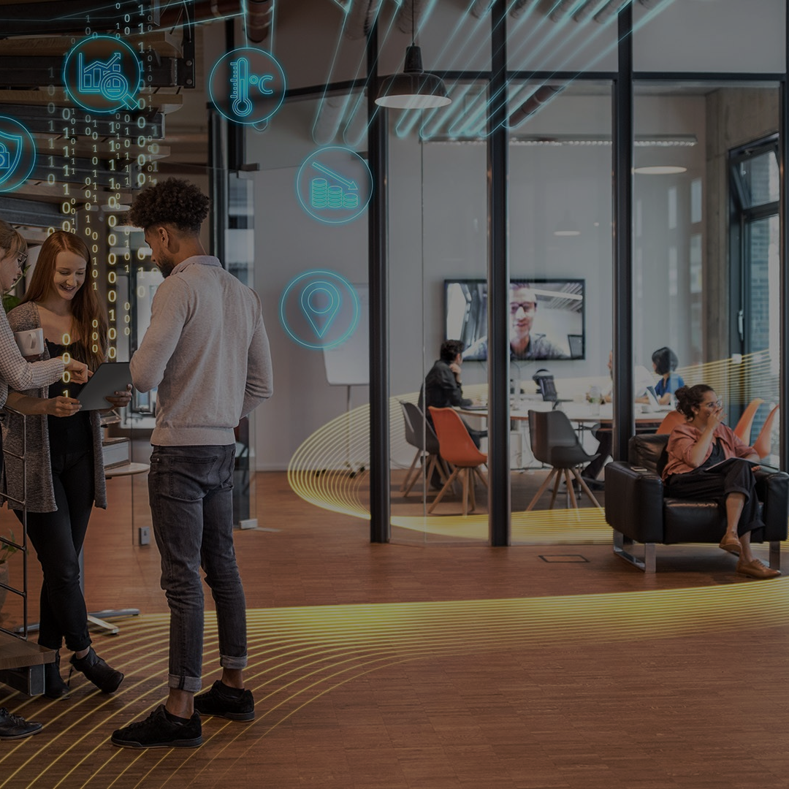
Change your workspace

Slide 3

It’s time
for coffee

Slide 4
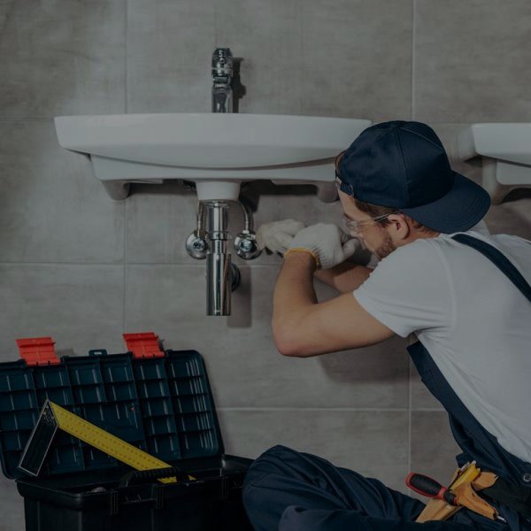
No water at Friday, 24 Nov.

Slide 5
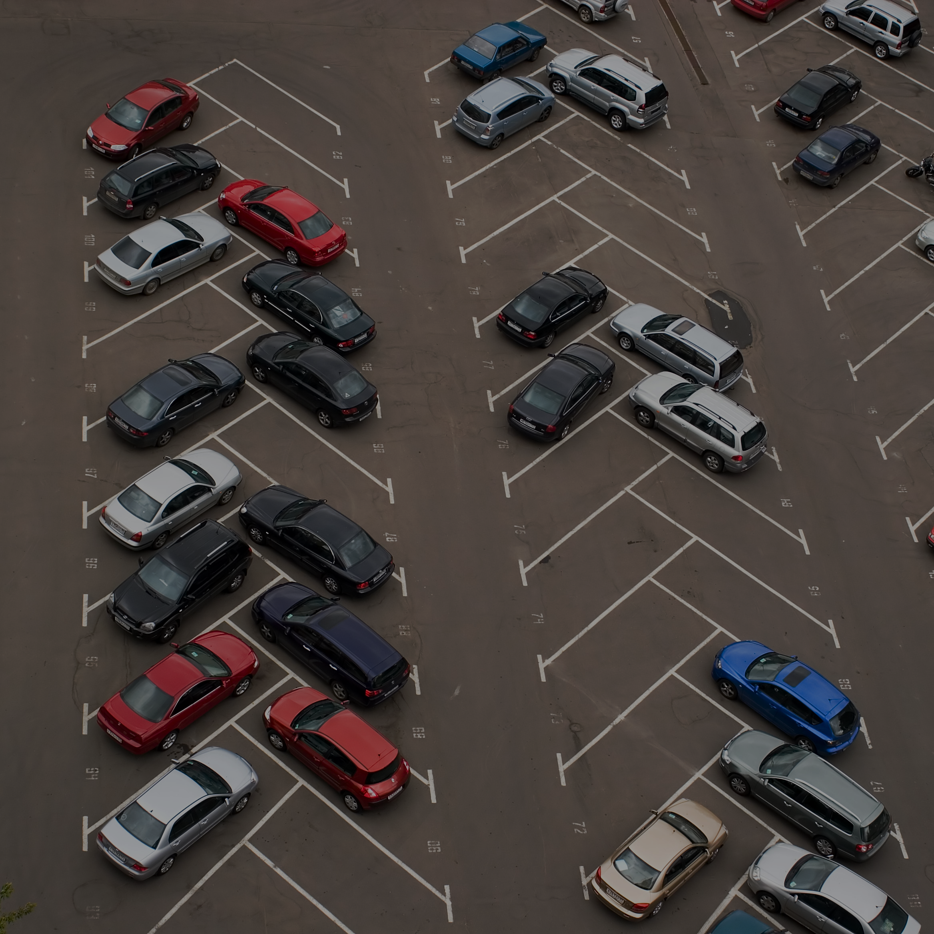
Parking place

